Slide 1
COS 212 Binary Trees

Slide 2
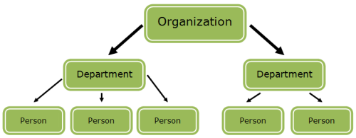
Tree ADT: Introduction
Linked lists are more flexible than arrays: insertion and deletion is more efficient
Search/random access emulation is not efficient, though
Both linked lists and arrays are linear
What if we need to represent a hierarchical structure?
Trees: efficiently searchable hierarchical data structures

Slide 3
Tree ADT
arc
root
nonterminal node
parent
child
leaf
(terminal node)

Slide 4

Tree ADT
Trees can be defined recursively:
An empty structure is an empty tree
If $t_{1}, …, t_{k}$ are disjoint trees, then the structure whose root is a parent of the roots of $t_{1}, …, t_{k}$ is also a tree
Only structures generated by rules (1) and (2) are trees

Slide 5


Tree ADT: Terminology
Each node has to be reachable from the root by a unique sequence of arcs, called a path

Slide 6
Tree ADT: Terminology
Number of arcs in the path is called length of the path
A to B: 1
A to E: 2
Level of the node is the length of the path from root to node + 1
Level of A: 1
Level of E: 3
Height of a non-empty tree is the maximum level of a node in the tree
Height of the tree on this slide: 3
A
B
C
D
E
F

Slide 7
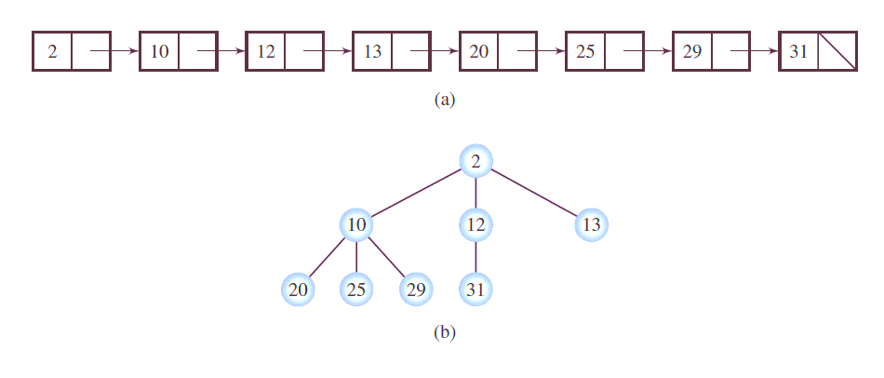
Tree ADT
Hierarchical structure is good, but what we’re really after is an efficiently searchable data structure
What if we make a tree out of a sorted linked list?
Access 25?
Access 12?

Slide 8
Binary Trees
A binary tree is a tree where each node has a maximum of 2 children, and each child is either left or right
Binary tree examples:

Slide 9




Binary Trees
A complete binary tree is a binary tree with exactly $2^{(i−1)}$ leaves at each level $i$
Number of nodes doubles per level
Level: 1, # nodes: $2^{0}$ = 1
Level: 2, # nodes: $2^{1}$ = 2
Level: 3, # nodes: $2^{2}$ = 4

Slide 10
Binary Search Tree
An ordered binary tree is a binary tree where for each node n:
Values stored in left subtree are less than the value stored in n
Values stored in the right subtree are greater than the value stored in n
n
el
left subtree of n
right subtree of n
< el
> el

Slide 11
Binary Search Trees
Binary search tree examples:
A
8
5
D
3
7
C
E
y
1
6
9
z
6
1

Slide 12
Implementing Binary Search Trees
public class BSTNode<T extends Comparable<? super T>> {
protected T el;
protected BSTNode<T> left, right;
// constructors
}
Refer to page 228 for explanation
el
abbreviated as:
el

Slide 13
Binary Search Trees
Searching a binary search tree for a value m:
Start from the root. If root is not NULL:
If m == root.el, end search
If m < root.el, search left subtree
If m > root.el, search right subtree
5
3
7
1
6
9

Slide 14
Binary Search Trees
search(el)
p = root;
while p is not null
if element in node p equals el
return element in node p; // el was found;
else if el < element in node p
p = p.left;
else p = p.right;
return null; // el was not found;
Can we re-write the algorithm recursively?
5
3
7
1
6
9

Slide 15
Binary Search Trees
search(el,root)
if root is null
return null; // el was not found;
else if element in root equals el
return element in root; // el was found;
else if el < element in root
return search(el,root.left);
else
return search(el,root.right);
What type of recursion is this?
5
3
7
1
6
9

Slide 16
Binary Search Trees
5
How efficient is the search?
search(el)
p = root;
while p is not null
if element in node p equals el
return element in node p; // el was found;
else if el < element in node p
p = p.left;
else p = p.right;
return null; // el was not found;
Count the number of operations!
3
7
1
6
9

Slide 17
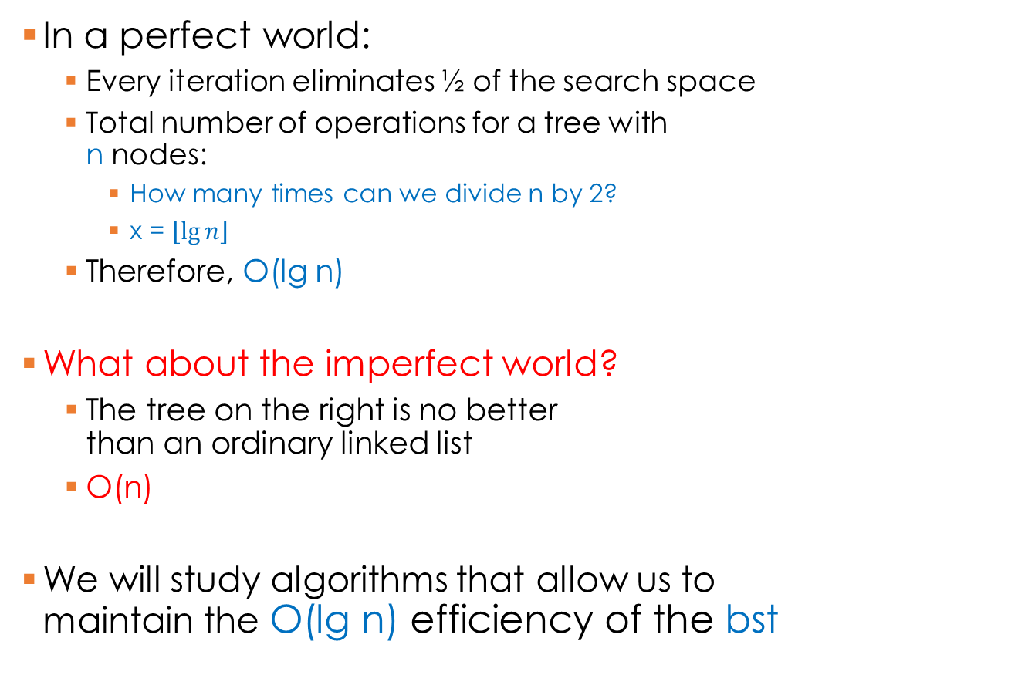
Binary Search Trees
5
In a perfect world:
Every iteration eliminates ½ of the search space
Total number of operations for a tree with n nodes:
How many times can we divide n by 2?
x = $\left\lfloor \lg{n}\right\rfloor$
Therefore, O(lg n)
What about the imperfect world?
The tree on the right is no better than an ordinary linked list
O(n)
We will study algorithms that allow us to maintain the O(lg n) efficiency of the bst
3
7
1
6
9
A
D
E
F
Z

Slide 18
Binary Search Trees
Why are we interested in trees:
They provide a hierarchical structure
Binary search trees allow for efficient searching
Suppose you store your data in a binary tree, and you want to output all of it to a file
How do you systematically access every node in a tree?
5
3
7
1
6
9

Slide 19
Binary Search Tree: Traversals
Tree traversal:
The process of visiting each node in the tree exactly once
Total number of traversals for a tree of size n: n! (number of permutations)
However, we are not interested in every chaotic permutation
Two traversal types:
Breadth-first
Depth-first
5
3
7
1
6
9

Slide 20
Breadth-first Traversal
Breadth-first:
Visit every node layer-by layer
5
3
7
1
6
9

Slide 21
Breadth-first Traversal
public void breadthFirst() {
BSTNode<T> p = root; // start at the root
// Use a queue:
Queue<BSTNode<T>> queue = new Queue<BSTNode<T>>();
if (p != null) { // if tree is not empty…
queue.enqueue(p); // enqueue root
while (!queue.isEmpty()) {
p = queue.dequeue();
visit(p); // do something – eg output
if (p.left != null)
queue.enqueue(p.left);
if (p.right != null)
queue.enqueue(p.right);
} // at every iteration, dequeue the node,
} // visit it, and enqueue its left and right
} // children

Slide 22
Breadth-first Traversal: Example
20
iteration | queue | out
init
10
30
20
1
10 30
20
15
25
2 |  | 10
30
15
3 |  | 30
15
25
23
27
4 |  | 15
25
5 |  | 25
26
23 27
6 |  | 23
27
queue.enqueue(p);// enqueue root
while(!queue.isEmpty()) {
p = queue.dequeue();
visit(p); // output
if (p.left != null)
queue.enqueue(p.left);
if (p.right != null)
queue.enqueue(p.right);
}
7 |  | 27
26
8 |  | 26

Slide 23
Depth-first Traversal
Depth-first:
Traverse as deep as possible on each child before going to the next child.
Question: when traversing a tree, what do we output first: the parent or the children?
5
3
7
1
6
9

Slide 24
Depth-first Traversal
Preorder traversal: Parent first
Parent is visited first, then its children are visited
5
public void preorder() {
preorder(root);
}
protected void preorder(BSTNode<T> p)
{
if (p != null) {
visit(p);
preorder(p.left);
preorder(p.right);
}
}
3
7
1
6
9
5
3
1
7
6
9

Slide 25
Depth-first Traversal
Inorder traversal: Left, Parent, Right
Left child is visited first, then parent, then the right child
5
public void inorder() {
inorder(root);
}
protected void inorder(BSTNode<T> p)
{
if (p != null) {
inorder(p.left);
visit(p);
inorder(p.right);
}
}
3
7
1
6
9
1
3
5
6
7
9

Slide 26
Depth-first Traversal
Postorder traversal: Children first
Children are visited first, then the parent
5
public void postorder() {
postorder(root);
}
protected void postorder(BSTNode<T> p)
{
if (p != null) {
postorder(p.left);
postorder(p.right);
visit(p);
}
}
3
7
1
6
9
1
3
6
9
7
5

Slide 27
Binary Search Tree ADT
A linked list that branches out from the root using left and right pointers
Binary Search Tree (BST):
all values in the left subtree must be smaller than the parent
all values in the right subtree must be larger than the parent
Every sub-tree (branch) is also a BST
Efficient search: O(lg n)
Traversal: breadth-first, depth-first
Depth-first, inorder: left->parent->right
5
3
7
protected void inorder(BSTNode<T> p)
{
if (p != null) {
inorder(p.left);
visit(p);
inorder(p.right);
}
}
1
6
9

